Slide 1
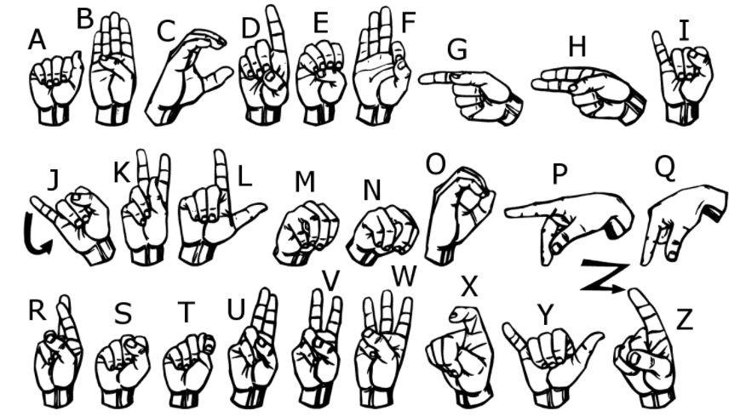
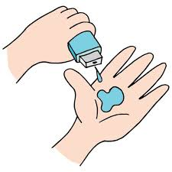
ABHISHEK CHAKRABORTY
Student ID: STU61507abd9adb81632664253
AICTE Email: 1da19ml001.ml@drait.edu.in
Personal Email: ronnieabhishek98@gmail.com
Institute: Dr. Ambedkar Institute of Technology, Bengaluru
Phone: +91-8088344949
Internship on:
AMERICAN SIGN LANGUAGE RECOGNITION USING MACHINE LEARNING ALGORITHM

Slide 2
PROJECT TITLE
American Sign Language (ASL) recognition Using Machine Learning Algorithm

Slide 3
AGENDA
One approach to communicate with the deaf is through sign language. There is no universally recognised sign language. There are many variations of sign languages because, like spoken languages, they evolved naturally via interaction between various groups of people. Between 138 and 300 different sign languages are currently in use all over the world. One of them is American Sign Language. The main obstacles that have prevented more research on American Sign Language from being done in this body of work are incorporated features and local language variance. To communicate with them, sign language should be learned. Peer groups are typically where learning happens. There aren't many study resources accessible for learning signs. The process of learning sign language is therefore a very challenging undertaking. Finger spelling is the first stage of sign learning, and it is also used when there is no corresponding sign or when the signer is unaware of it. The majority of the currently available sign language learning systems rely on pricey external sensors. By gathering a dataset and using various feature extraction techniques to extract relevant data, our study intends to advance this subject. This data is then used as input into machine learning techniques. Currently, we have published all of the validated results for the techniques, and the improvement over earlier work can be attributed to the results' consistently high accuracy. In upcoming studies, the validation set will correspond to pictures of people who aren't the same as the people in the training set.

Slide 4
PROBLEM STATEMENT
Given a hand gesture, implementing such an application that detects sign language in real time through hand gestures and allowing the user to get the accurate values of the result of the character detected in a live video taken as well as allowing such users to build their customised gesture so that the problems faced by people who are unable to talk vocally can be accommodated with technological assistance and the barrier of expression can be overcome. This motivated me to work for the project.

Slide 5
PROJECT OVERVIEW
We created one database of images of alphabets A to Z (26 folders). Each alphabet folder has 101 images.
After that we created one model using machine learning algorithm.
Then, we trained all images using the model.
After training part is done, testing is required. So from live video, we will be testing signs.
Accordingly, we will get the name of the signs along with the accuracies on the side of the box.

Slide 6

WHO ARE THE END USERS?
It is most commonly used by deaf & dumb people who have hearing or talking disorders to communicate among themselves.
Even normal people can use this to communicate with the deaf and dumb people.

Slide 7
YOUR SOLUTION AND ITS VALUE PROPOSITION
Images of signs of different alphabets are taken and those all images are trained with model created.
Several parameters are checked for running the model and training the model, and accordingly accuracies are checked.
The more accuracy, the more efficiency will be there for the users to use the technology for betterment of their communication.

Slide 8
THE WOW IN YOUR SOLUTION
The model made, makes the whole process more stable than the previous works done by others.
More accuracy in output which makes the whole process unique than the others.

Slide 9
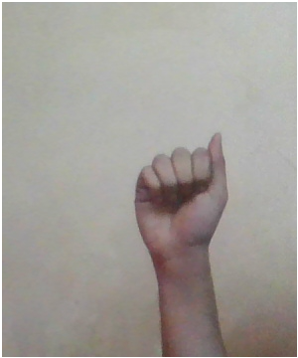
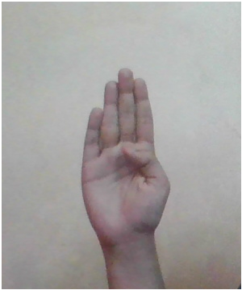
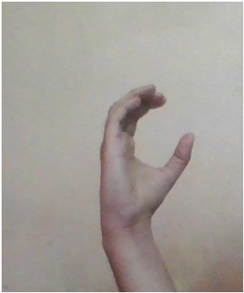
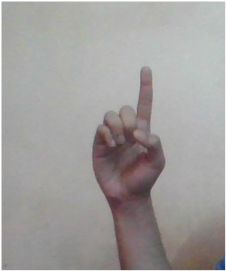
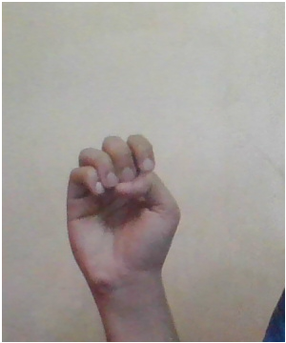
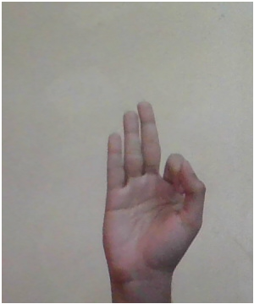
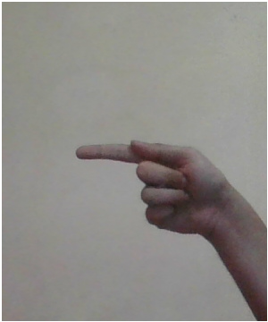
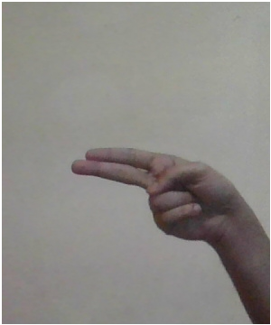
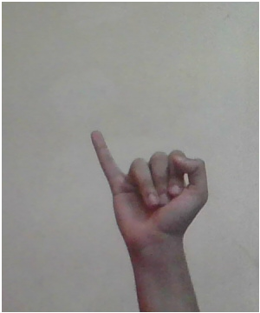
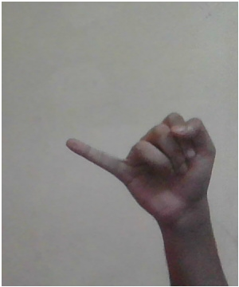
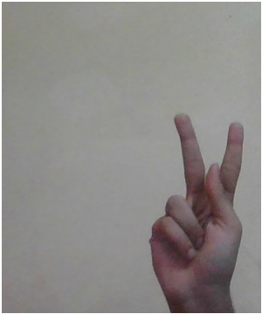
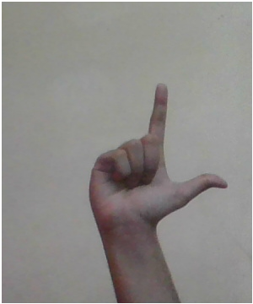
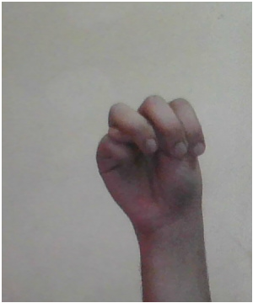
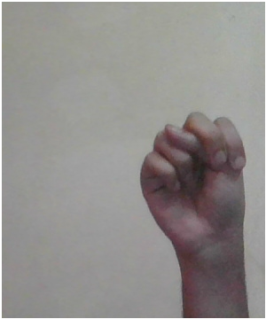
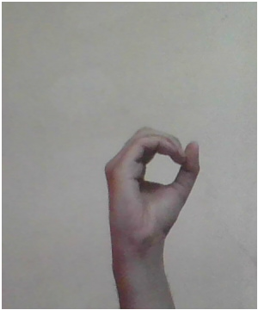
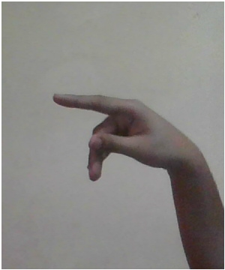
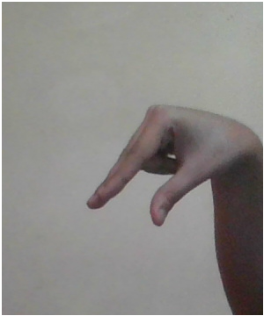
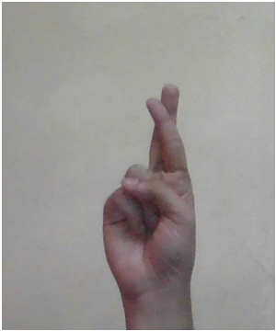
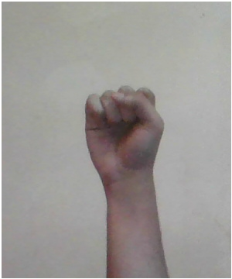
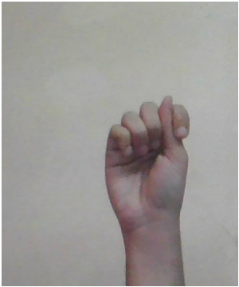
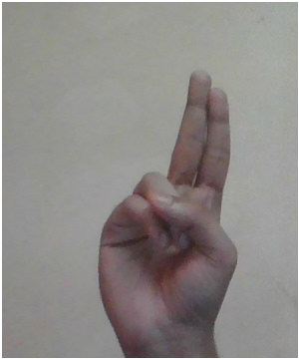
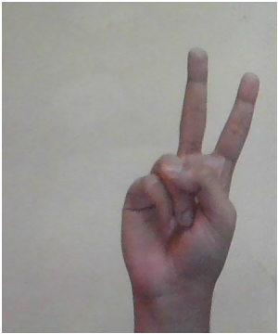
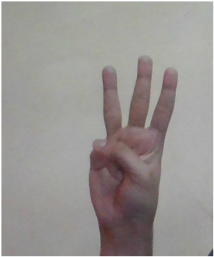
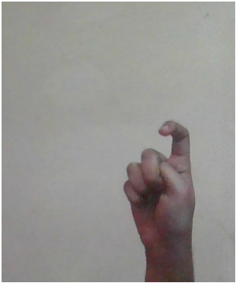
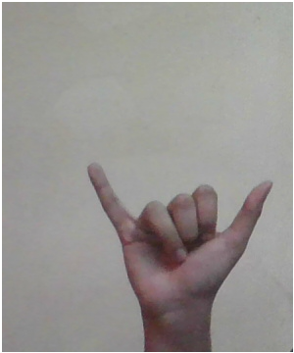
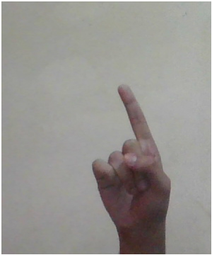
DATASET USED
To get access of the whole dataset, please click the link:
https://drive.google.com/drive/folders/1kkSK-MFVe8OL_UJVek_xZSZNbqGcj9md?usp=sharing

Slide 10
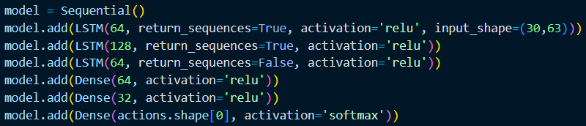
MODEL
Model used for training the images:-
LSTM networks are well-suited to classifying, processing and making predictions based on time series data, since there can be lags of unknown duration between important events in a time series. LSTMs were developed to deal with the vanishing gradient problem that can be encountered when training traditional RNN.
To check the model please refer to the github link:-
https://github.com/Chakraborty98/Sign_Language_Recognition_Using_ML/blob/main/model.json

Slide 11
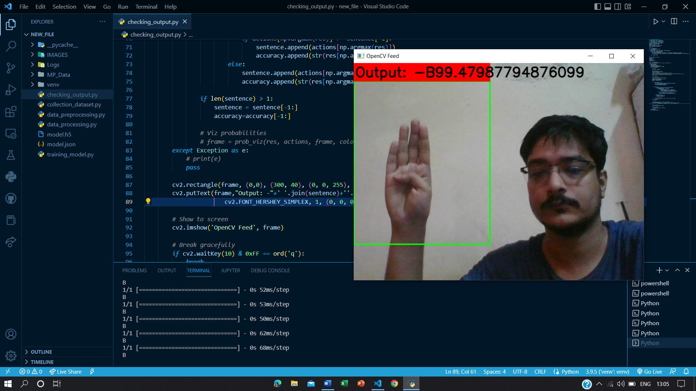
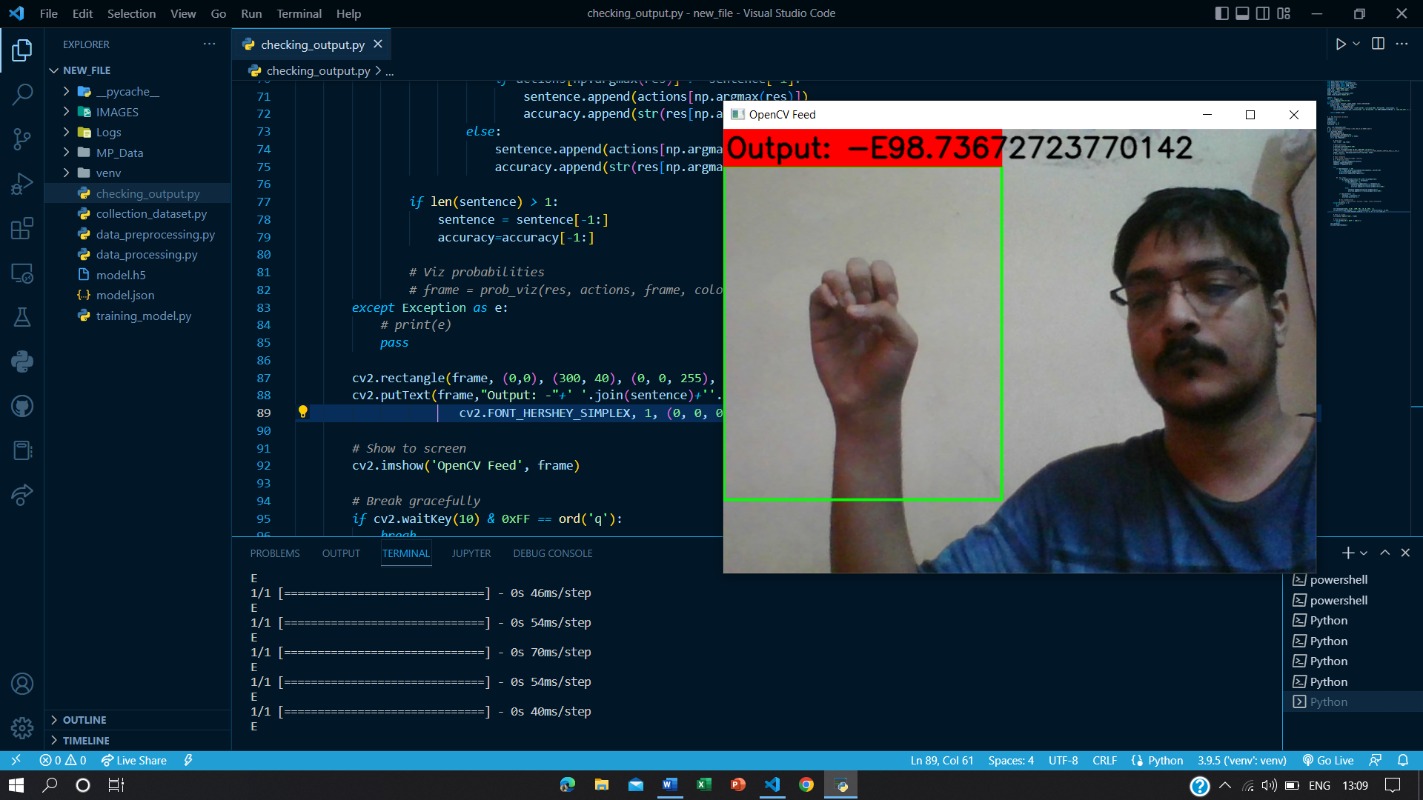
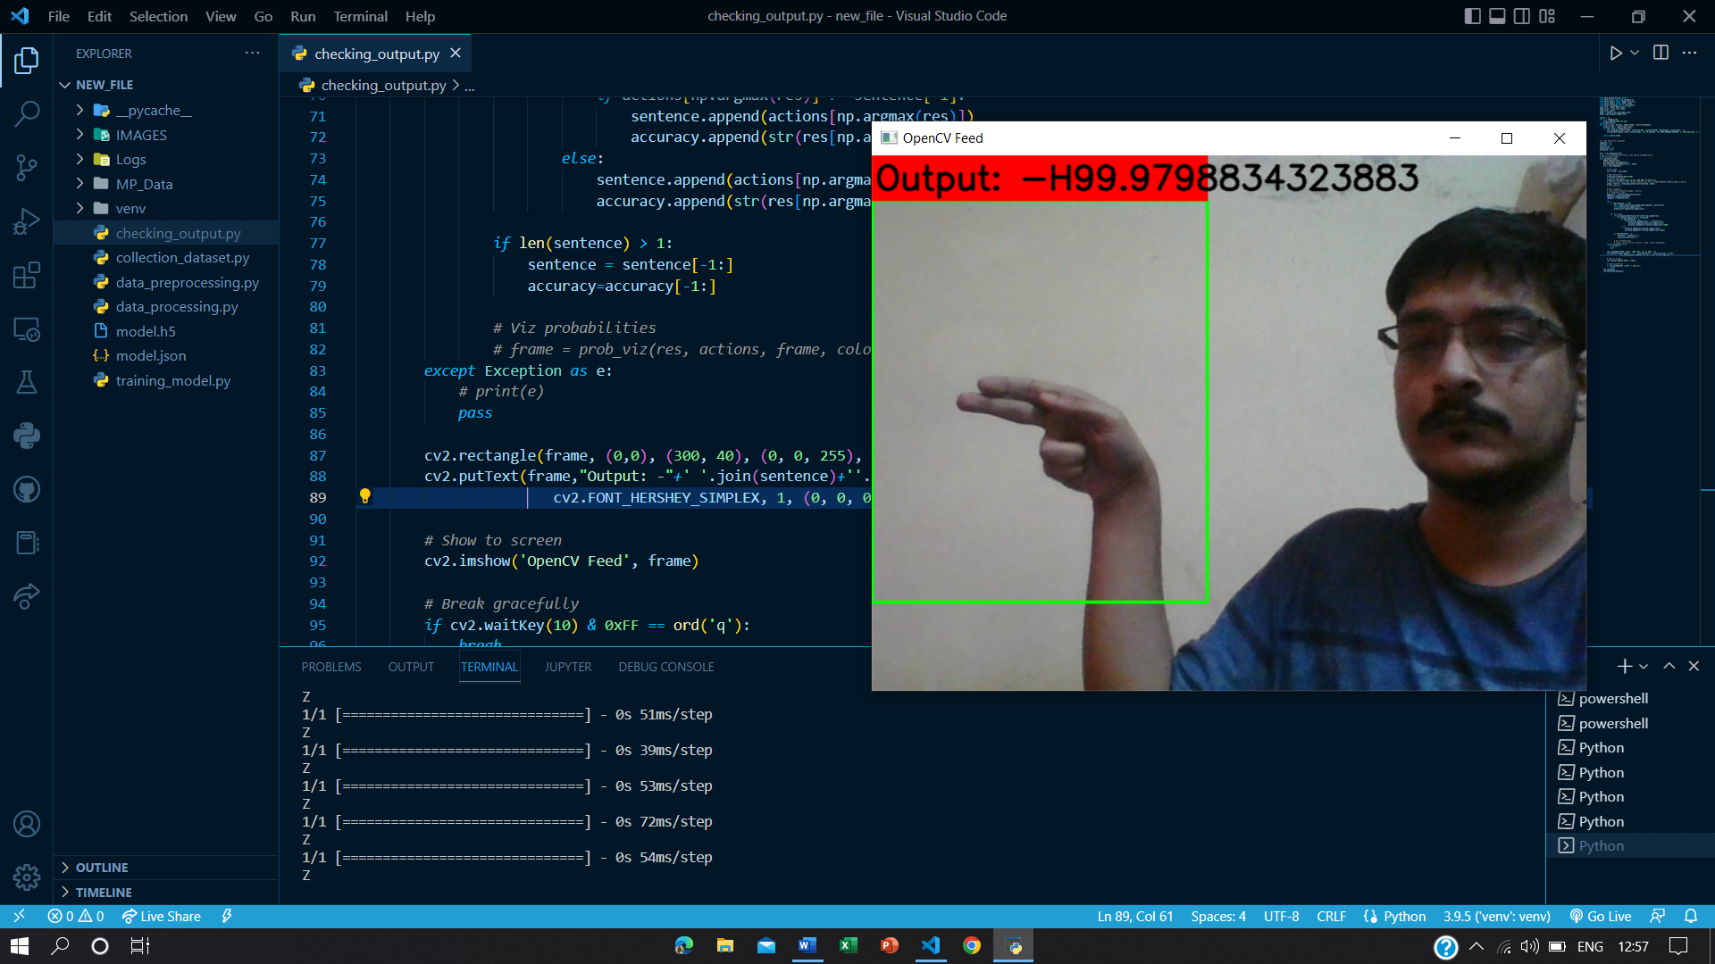
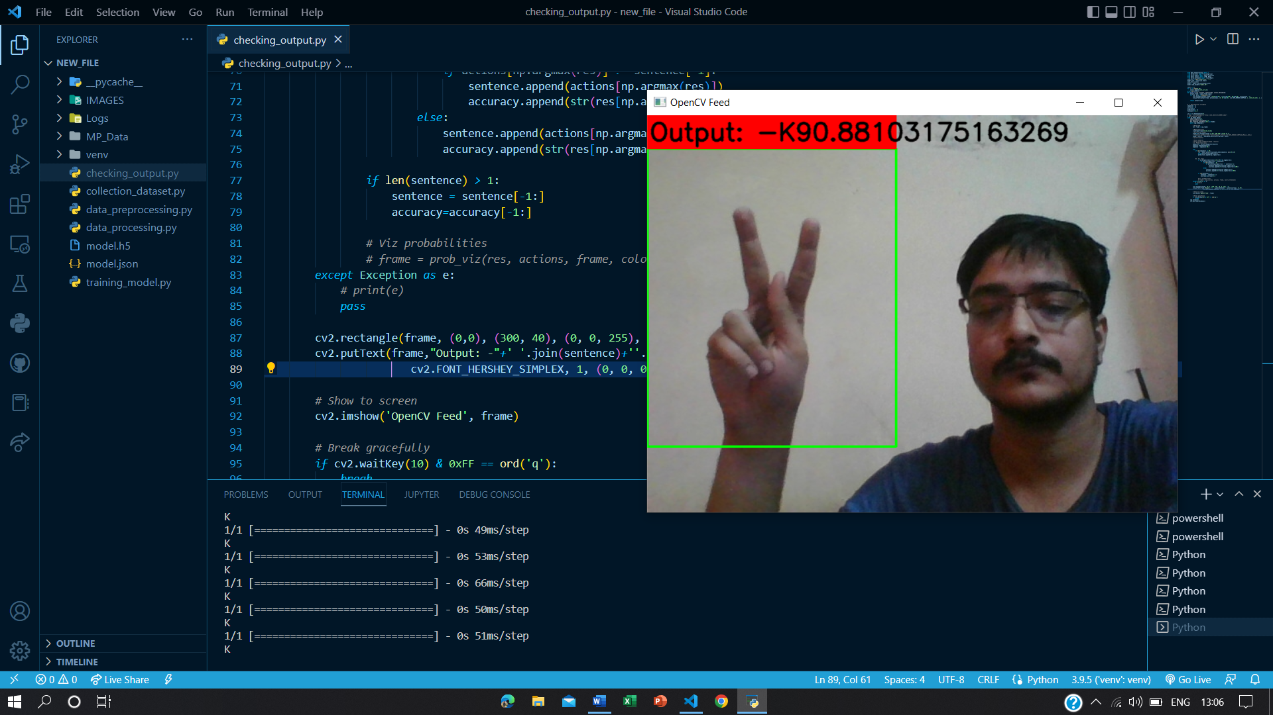
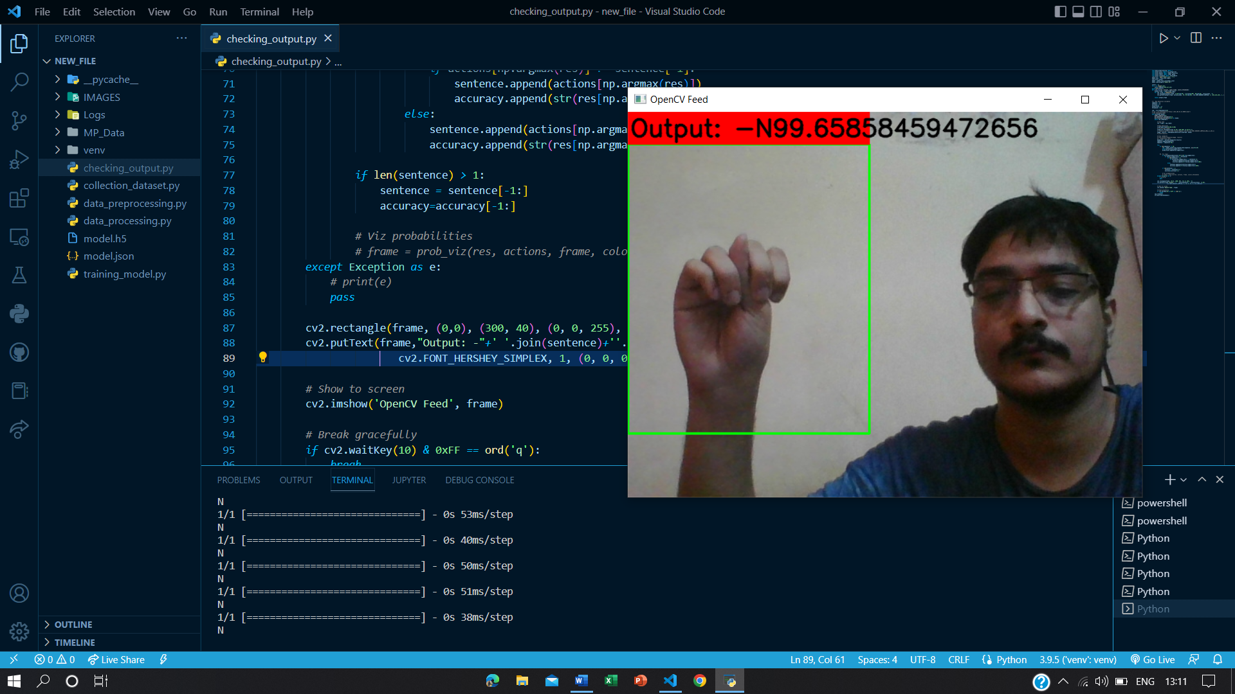
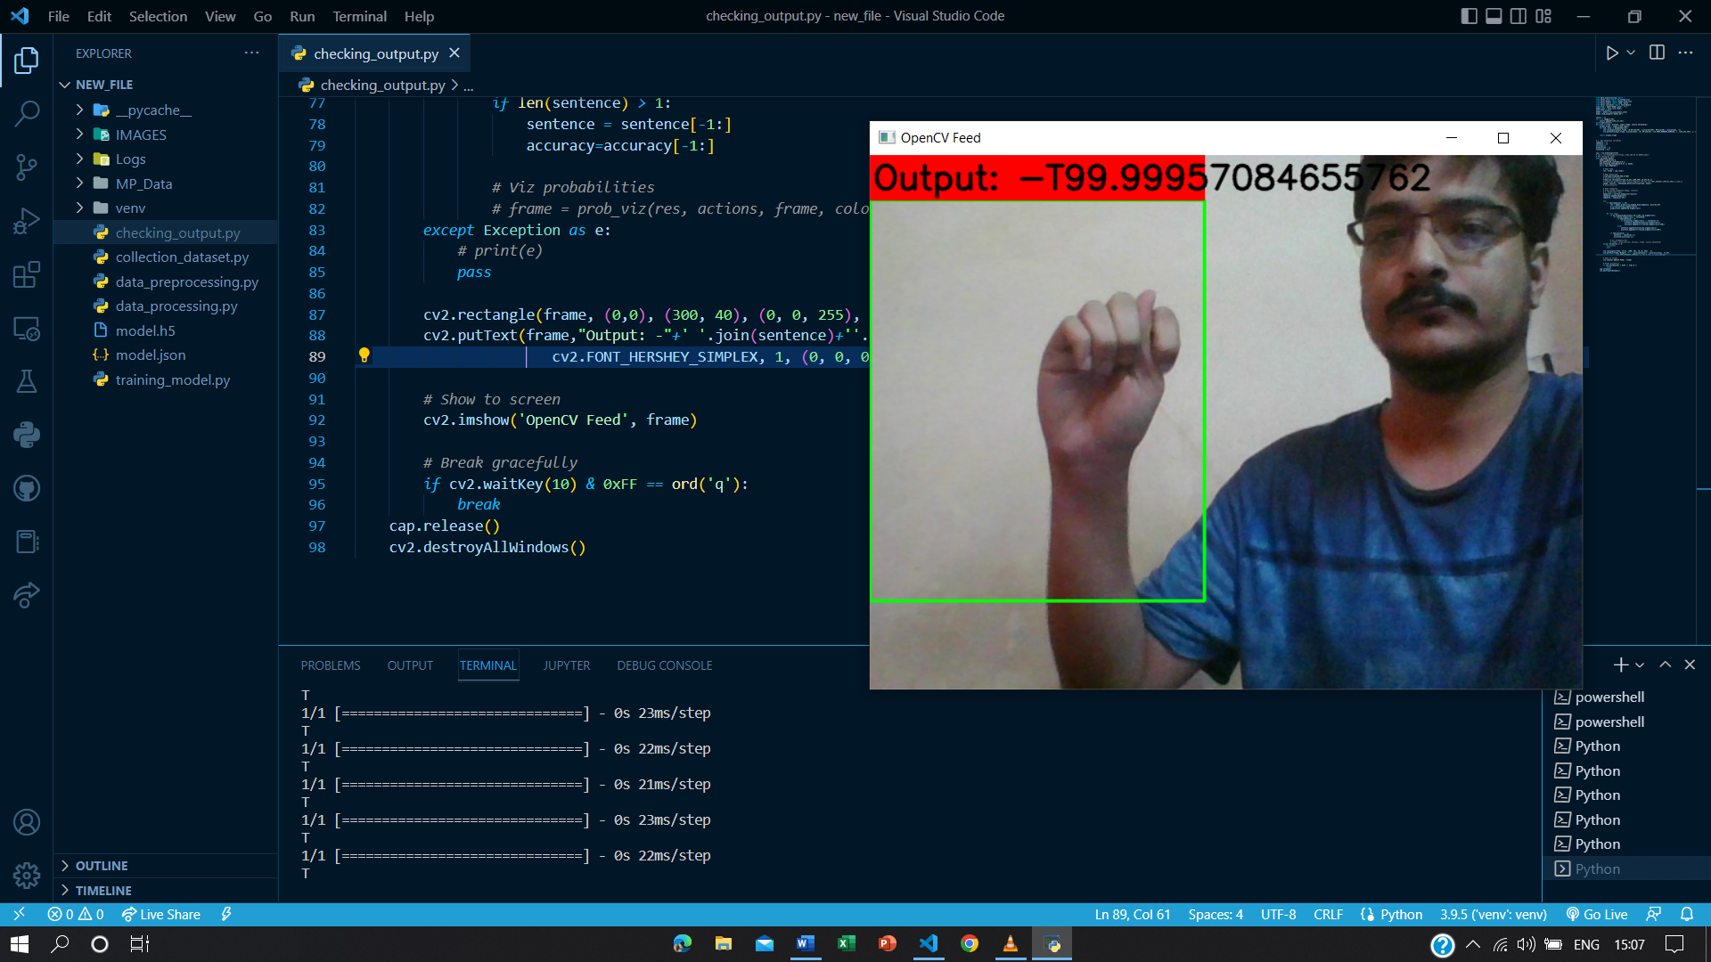
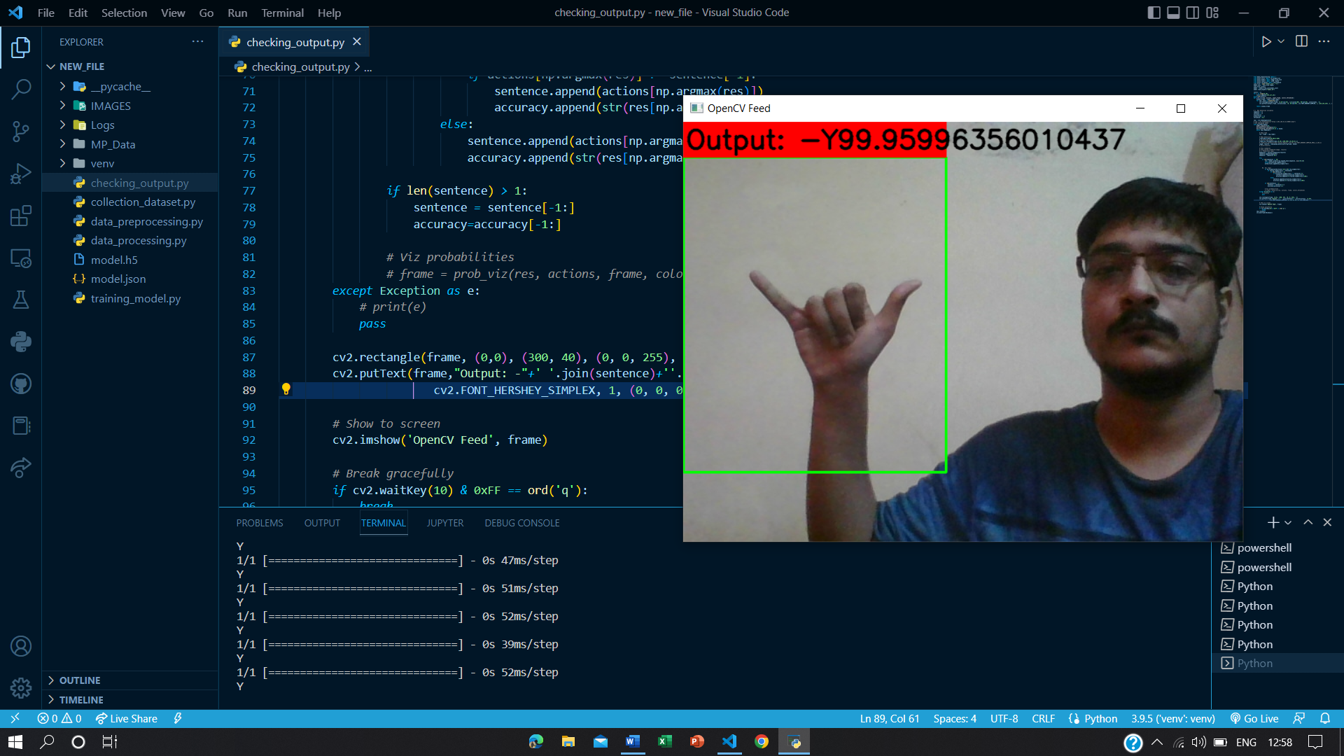
RESULTS
Here are some screenshots regarding output:-
To check the full output and the codes, please go through the link:-
https://github.com/Chakraborty98/Sign_Language_Recognition_Using_ML

Slide 12
RESULTS
ALPHABET | ACCURACY | ALPHABET | ACCURACY | ALPHABET | ACCURACY
A | 91.95 % | J | 82.94 % | S | 89.21 %
B | 99.47 % | K | 90.88 % | T | 99.99 %
C | 82.21 % | L | 80.89 % | U | 89.78 %
D | 99.98 % | M | 100 % | V | 100 %
E | 98.73 % | N | 99.65 % | W | 85.16 %
F | 87.45 % | O | 100 % | X | 95.69 %
G | 99.99 % | P | 99.18 % | Y | 99.96 %
H | 99.98 % | Q | 100 % | Z | 99.99 %
I | 90.49 % | R | 99.99 % | Some alphabets are having problem In accuracy

Slide 13
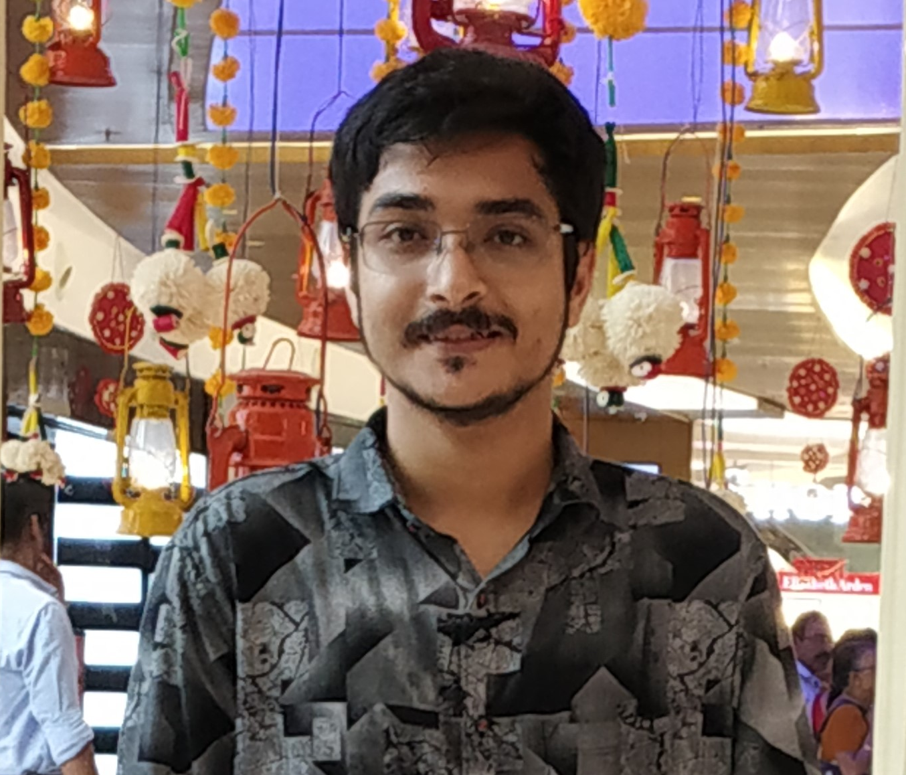
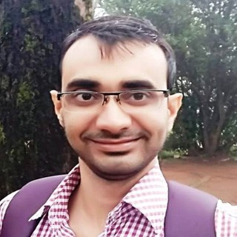
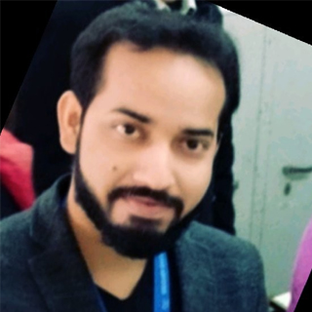
MEET OUR TEAM
Abhishek Chakraborty [4th Year BE Medical Electronics student,
Dr. Ambedkar Institute of Technology, Bengaluru]
Bassar Patel [Mentor, Edunet Foundation]
.
.
Utkarsh Sharma [Mentor, Edunet Foundation]

